Slide 1
Introduction to Digital Electronics

Slide 2
Lecture 3 Number System
Lecture delivered by:
Deepak V.

Slide 3
Objectives
At the end of this lecture, student will be able to:
Describe Number System
Distinguish between various number systems
Acquire the knowledge of Data Organization

Slide 4
Topics
Number System
Binary Digits
Decimal Number System
Octal number system
Hexadecimal number system

Slide 5
Positional Notation
Value of number is determined by multiplying each digit by a weight and then summing
Value of number is determined by multiplying each digit by a weight and then summing.
The weight of each digit is a POWER of the RADIX and is determined by position.
The weight of each digit is a POWER of the RADIX (also called BASE) and is determined by position

Slide 6
Radix (Base) of a Number System
Decimal Number System (Radix = 10)
Example:- 7392 = 7x103+3x102+9x101+2x100
Binary Number System (Radix = 2)
Example:- 101.101 = 1x22+0x11+1x20+1x2-1+0x2-11x2-2
Octal number system (radix = 8)
Hexadecimal number system (radix = 16)

Slide 7
Radix (Base) of a Number System
When counting upwards in base-10, we increase the units digit until we get to 10 when we reset the units to zero and increase the tens digit.
So, in base-n, we increase the units until we get to n when we reset the units to zero and increase the n-s digit.
Consider hours-minutes-seconds as an example of a base-60 number system:
Example: 12:58:43 + 00:03:20 = 13:02:03
The base of a number is often indicated by a subscript
E.g. (123)10 indicates the base-10 number 123.

Slide 8
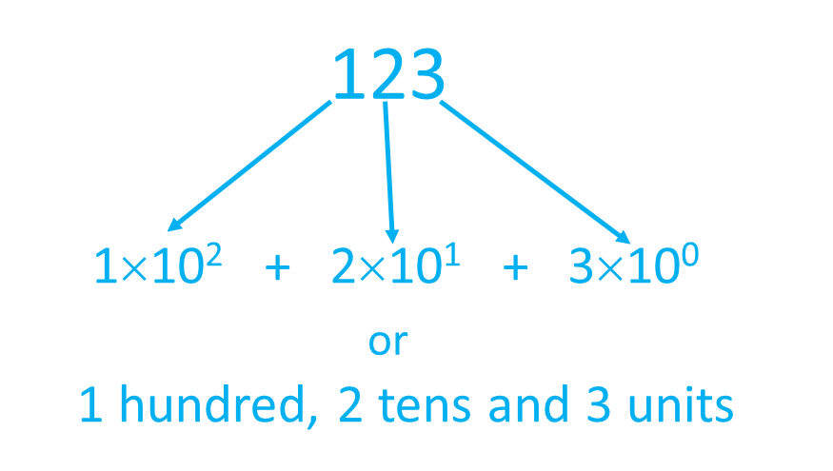
Decimal Number Systems
Base 10
Ten digits, 0-9
Columns represent (from right to left) units, tens, hundreds etc

Slide 9
Binary Number System
Base 2
Two digits, 0 & 1
Columns represent (from right to left) units, twos, fours, eights etc
1111011
1×2⁶ + 1×2⁵ + 1×2⁴ + 1×2³ + 0×2² + 1×2¹ + 1×2⁰
= 1×64 + 1×32 + 1×16 + 1×8 + 0×4 + 1×2 + 1×1
= 123

Slide 10
Binary Numbers
Each binary digit (called bit) is either 1 or 0
Bits have no inherent meaning, can represent
Unsigned and signed integers
Characters
Floating-point numbers
Images, sound, etc
Bit Numbering
Least significant bit (LSB) is rightmost (bit 0)
Most significant bit (MSB) is leftmost (bit 7 in an 8-bit number)
Most
Significant Bit
Least
Significant Bit
7
6
5
4
3
2
1
0
1
0
0
1
1
1
0
1
2
7
2
6
2
5
2
4
2
3
2
2
2
1
2
0

Slide 11

Data Organization
Bits
Or one, true or false, on or off, male or female, and right or wrong
Nibbles
Group of 4 bits
Bytes

Slide 12
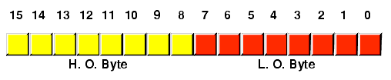
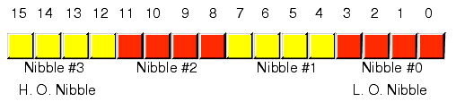
Words
Representation of Words

Slide 13


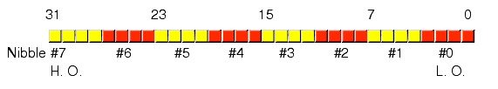
Double Words
Representation of Double Words

Slide 14
Octal Number System
Base 8
Eight digits, 0-7
Columns represent (from right to left) units, 8s, 64s, 512s etc
173
1×8² + 7×8¹ + 3×8⁰ = 123

Slide 15
Hexadecimal Number System
Base 16
Sixteen digits, 0-9 and A-F (ten to fifteen)
Columns represent (from right to left) units, 16s, 256s, 4096s etc
7B
7×16¹ + 11×16⁰ = 123

Slide 16
Decimal, Binary, Octal and Hexadecimal
Decimal | Binary | Octal | Hex
00 | 0000 | 00 | 0
01 | 0001 | 01 | 1
02 | 0010 | 02 | 2
03 | 0011 | 03 | 3
04 | 0100 | 04 | 4
05 | 0101 | 05 | 5
06 | 0110 | 06 | 6
07 | 0111 | 07 | 7
08 | 1000 | 10 | 8
09 | 1001 | 11 | 9
10 | 1010 | 12 | A
11 | 1011 | 13 | B
12 | 1100 | 14 | C
13 | 1101 | 15 | D
14 | 1110 | 16 | E
15 | 1111 | 17 | F
Decimal, Binary, Octal and Hexadecimal

Slide 17
Summary
Value of number is determined by multiplying each digit by a weight and then summing
Binary Number System has Radix = 2
Decimal Number System has radix = 10
Octal number system has radix = 8
Hexadecimal number system has radix = 16

